Slide 1
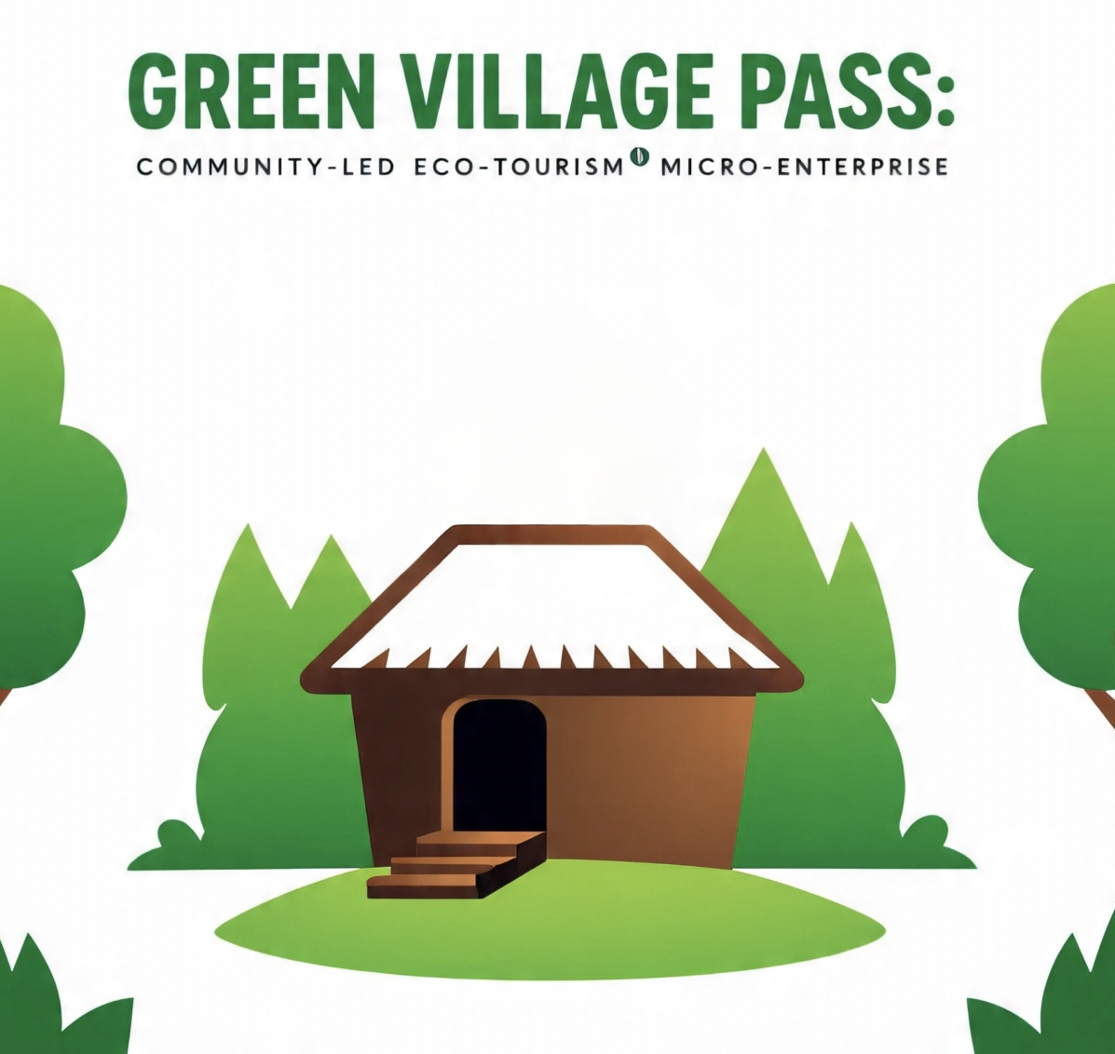

Slide 2
Green Village Pass is a WhatsApp and website -based tourism booking and carbon tracking system that connects eco-conscious tourists directly with rural communities, creating immediate income while promoting environmental conservation through gamified sustainability challenges.

Slide 3

Green village pass

Slide 4
1. PROJECT FUNCTIONALITY & INNOVATION
Revolutionary Low-Tech Solution: “WhatsApp Tourism Hub”
Core Innovation: Africa’s first community-managed tourism network using existing mobile infrastructure (WhatsApp Business) combined with simple environmental tracking tools.

Slide 5
How It Works:
1. Tourist Discovery: QR codes at transport hubs link to WhatsApp group
2. Community Experiences: Direct booking with village hosts via WhatsApp
3. Eco-Challenges: Simple photo-based environmental activities (tree planting, waste cleanup, water conservation)
4. Rewards System: Village-made crafts and meals earned through eco-actions
5. Impact Tracking: Community members document environmental improvements Scientific Foundation (Low-Cost but Valid)

Slide 6
Environmental Monitoring Tools:
• Community-led photo documentation with GPS timestamps• Simple water quality test strips (pH, nitrates) - USD 50
• Reforestation tracking using smartphone apps (Forest Watcher - free)
• Waste measurement using basic weighing scales - USD 30
• Air quality assessment using low-cost PM2.5 monitors - USD 100

Slide 7
Validated Impact Methodology:
• Before/after photo documentation
• Community-based monitoring protocols
• Tourist activity carbon footprint calculator (spreadsheet-based)
• Monthly environmental impact reports

Slide 8
Industry Transformation Potential
• Bypasses expensive booking platforms - direct community engagement
• Creates authentic cultural exchange - tourists stay with families
• Immediate environmental action - every tourist contributes to conservation
• Replicable model - any community with smartphones can implement

Slide 9
2. BUSINESS MODEL & ENTREPRENEURSHIP (ULTRA-LEAN)
Revenue Streams (Immediate Income Generation)
1. Community Homestays: USD 15/night (50% to families) - USD 1,800/month potential
2. Cultural. BUSINESS MODEL & ENTREPRENEURSHIP (ULTRA-LEAN)
Experience Packages: USD 10/experience - USD 600/month potential
3. Eco-Challenge Participation: USD 5/tourist/activity - USD 300/month potential
4. Local Craft Sales: USD 20 average purchase - USD 800/month potential
5. Traditional Meal Services: USD 8/meal - USD 480/month potential
Total Monthly Community Revenue Potential

Slide 10
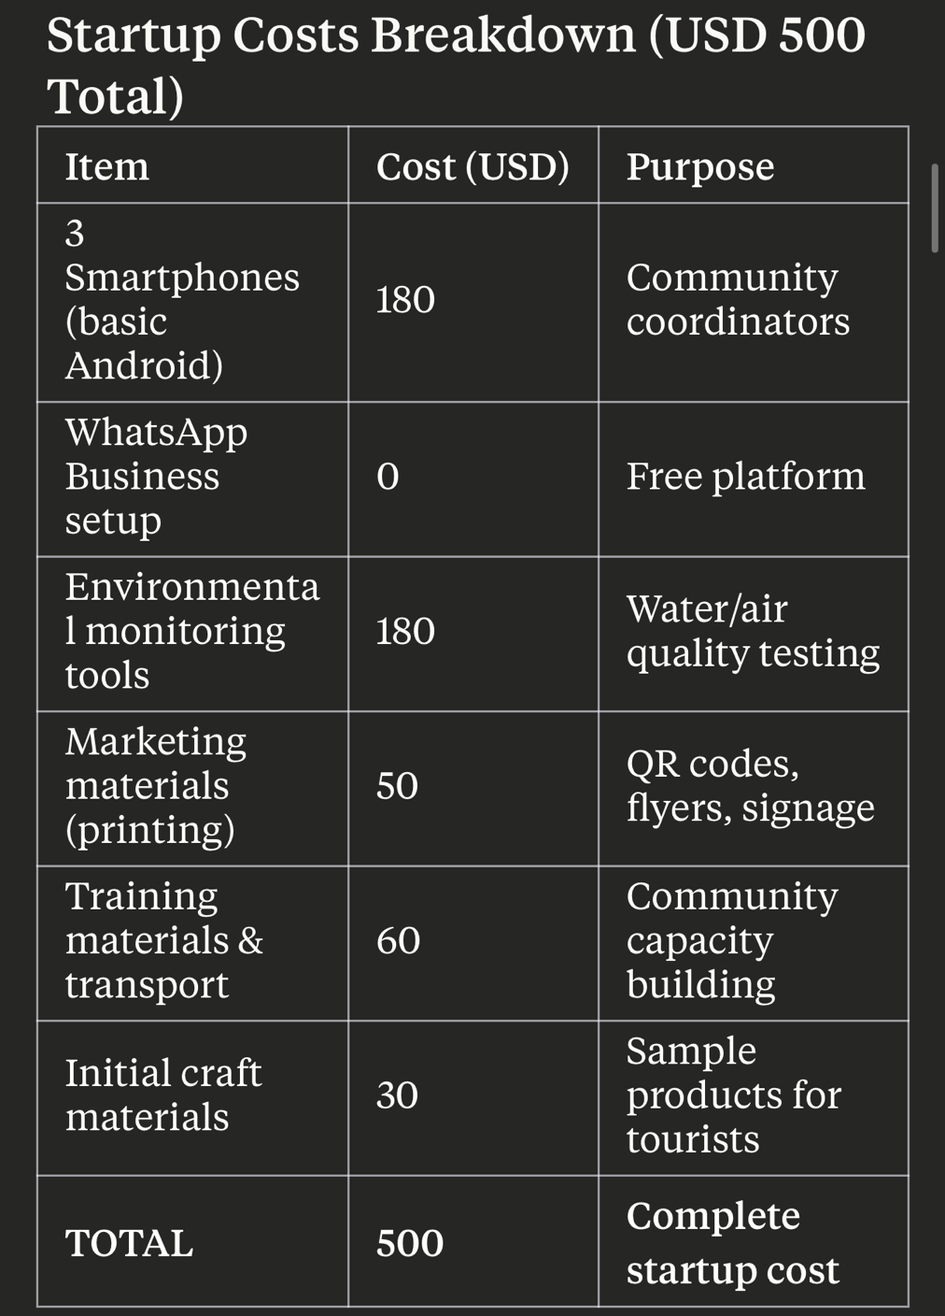
Total Monthly Community Revenue Potential: USD 3,980 Annual Projection: USD 47,760 direct community income

Slide 11
Business Sustainability Model
• Zero ongoing technology costs (WhatsApp Business is free)
• Community ownership - villages manage their own listings
• Minimal external dependencies - uses existing mobile network
• Scalable without additional investment - new villages can join freely

Slide 12
3. TECHNICAL IMPLEMENTATION (IMMEDIATELY DOABLE)
Phase 1: Quick Launch (Days 1-21)
Phase 2: System Optimization (Days 22-60)
Phase 3: Marketing & Growth (Days 61-180)

Slide 13
4 .COMPREHENSIVE TOURISM SUSTAINABILITY COVERAGE
1.Environmental Impact (Measurable with Simple Tools)
Direct Conservation Activities
Ecosystem protection initiatives
2. Social & Cultural Sustainability
Community Empowerment Outcomes
Heritage Preservation
3. Economic Sustainability Impact
Local Economic Development
Value Chain Integration

Slide 14
5. TEAM READINESS & PROFESSIONAL PRESENTATION
Core Implementation Team (Voluntary/Low-Cost)
Project Coordinator: Hillary Haym Y Mandaba ,Natural Resources Management and Tourism Studies Graduate
Community Liaison: Chiweshe Sabhuku, Village Elder
Technical Support: Tinashe Mudadi , Software engineering Student
Environmental Monitors: Tinevimbo Dzimiri and Hillary Mandaba Environmental Science student

Slide 15
Skill Development Completed
✓ Community Tourism Training: Rural Tourism Development Workshop (ZTA,UZ,KBA,Kwedu Tourism)
✓ Digital Marketing: Google Digital Skills Course (free online)
✓ Environmental Monitoring: Climate Change Commission training
✓ WhatsApp Business Management: Meta Business training (free)
✓ Cultural Sensitivity Training: UNESCO Intangible Heritage workshop

Slide 16
6. ALIGNMENT WITH UN-WTO OBJECTIVES
Direct SDG Contributions (Measurable Impact)
SDG 1 (No Poverty)
SDG 5 (Gender Equality)
SDG 8 (Decent Work)
SDG 11 (Sustainable Communities)
SDG 13 (Climate Action)
SDG 17 (Partnerships)

Slide 17
CONCLUSION
Green Village Pass
transformative sustainable tourism innovation does not require massive investment –
just creativity, community engagement, and strategic use of existing technology.
This project creates immediate economic impact while fostering environmental conservation and cultural preservation.
The beauty of this approach lies in its simplicity and replicability.
Zimbabwe Intellectual Property Office(ZIPO)
Green Village Pass is a trademark, trade name and marks, colours and logo
The copyright protects software with a technical effect is protected

Slide 18
This project proves that sustainable tourism transformation can start small, start local, and start now - embodying the true spirit of eco-resilient destinations through grassroots innovation and community empowerment.
“Big change starts with small steps’ - Green Village Pass is all about the experience and creating Eco friendly destinations.”

